Slide 1
INTERNSHIP PROJECT
ON
"STUDENT INFORMATION MANAGEMENT SYSTEM"
By
T. HRUTHIK REDDY (17311A1263)
L. ABHINAY (17311A12A7)
V. VENKATESH (17311A12A8)

Slide 2
INTRODUCTION
The student management system application will help in managing the student’s reports, results and exams will become easier with one such system. It will also help in saving time and effort. The user interface must be user friendly and easy to understand. The information of the particular student will be obtained in just one mouse click

Slide 3
Python features a dynamic type system and automatic memory management. It supports multiple programming paradigms, including object-oriented, imperative, functional and procedural, and has a large and comprehensive standard library.
Pandas: a library for data manipulation and analysis. The library provides data structures and operations for manipulating numerical tables and time series.

Slide 4
NumPy: The fundamental package for scientific computing with Python, adding support for large, multi-dimensional arrays and matrices, along with a large library of high-level mathematical functions to operate on these arrays.
SciPy: A library used by scientists, analysts, and engineers doing scientific computing and technical computing.

Slide 5
MODULES IMPORTED
Tkinter module:
Graphical User Interface(GUI) is a form of user interface which allows users to interact with computers through visual indicators using items such as icons, menus, windows, etc. It has advantages over the Command Line Interface(CLI) where users interact with computers by writing commands using keyboard only and whose usage is more difficult than GUI.

Slide 6
Tkinter is the inbuilt python module that is used to create GUI applications. It is one of the most commonly used modules for creating GUI applications in Python as it is simple and easy to work with. You don’t need to worry about the installation of the Tkinter module separately as it comes with Python already. It gives an object-oriented interface to the Tk GUI toolkit.

Slide 7
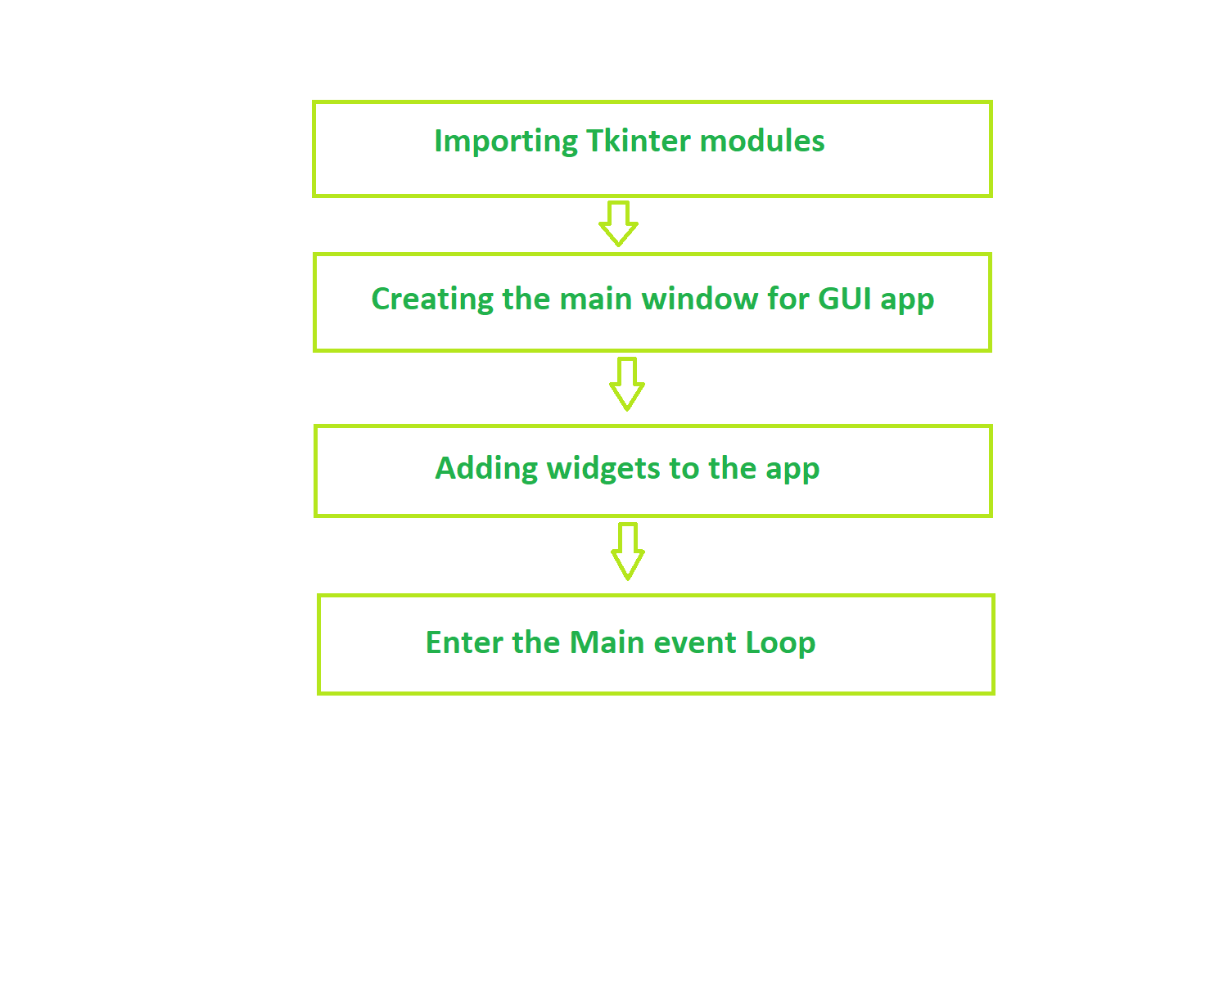
Fundamental structure of tkinter program

Slide 8
PANDAS:
Pandas is an open source library that is used to analyze data in Python. It takes in data, like a CSV or SQL database, and creates an object with rows and columns called a data frame. Pandas is typically imported with the alias pd.

Slide 9
The fundamental Pandas object is called a DataFrame. It is a 2-dimensional size-mutable, potentially heterogeneous, tabular data structure.
A DataFrame can be created multiple ways. It can be created by passing in a dictionary or a list of lists to the pd.DataFrame() method, or by reading data from a CSV file.

Slide 10
ER DIAGRAM (ENTITY-RELATIONAL)
ER-Diagram
ID
NAME
Ph no
ADDRESS
MANAGES
ADMIN
STUDENT
GENDER
TIME
DATE
DOB

Slide 11
USE CASE DIAGRAM
Add Student record
Update student record
Delete student record
Search student record
ADMIN
STUDENT
Use case diagram between Admin and Student

Slide 14
TECHNOLOGY OVERVIEW
The technology selected for implementing Student Information Management System is PYTHON/MYSQL .The development was done in a ‘windows’ environment using PYcharm IDE and MYSQL database.

Slide 15
Advantages:
Report Management
Automatic Timetable Generator
School Event Calendar
Effortless Assignment Management
Increased Data Security

Slide 16
Disadvantages
Inconsistency in data entry and generate errors.
System is fully dependent on skilled individuals.
Time consuming and costly to produce reports.
Entry of false information.

Slide 17
FUTURE ENHANCEMENT
The Student Management System can be enhanced to include some other functionality like marks , attendance management.
Talent management of students based on their performance evaluation can be added.
Social networking can also be added wherein students can interact with each other.
Online class functionality can be added.
Can be made available for all OS.

Slide 18
Can evolve as an online institution.
Functionality of chat and messages can be added.
Online exam functionality can be added.
Online resume builder functionality can also be added.

Slide 19
CONCLUSION:
The student management system is useful for all schools and colleges to maintain the data of their students
This system helps in maintaining the information of pupil of the organization. It can be easily accessed by the manager and kept safe for a long period of time without any changes.
In future this could be enhanced in so many ways to keep their data safe and secure

